Slide 1
Gambler’s Ruin and Random Walk Problem

Slide 2
Question
A reluctant gambler is dragged to the river boat casino by his more free-wheeling friends. He takes only $50 to gamble win.
Since he does not know much about gambling, he decides to play roulette. At each spin, he places $25 on red. If red occurs, he wins $25. If black comes up, he loses his $25. Therefore the odds of winning are 50%.
He will quit playing when he either has zero money left, or is up $25($75 total).
Let’s model this process as Markov chain and examine its long-run behavior.

Slide 3
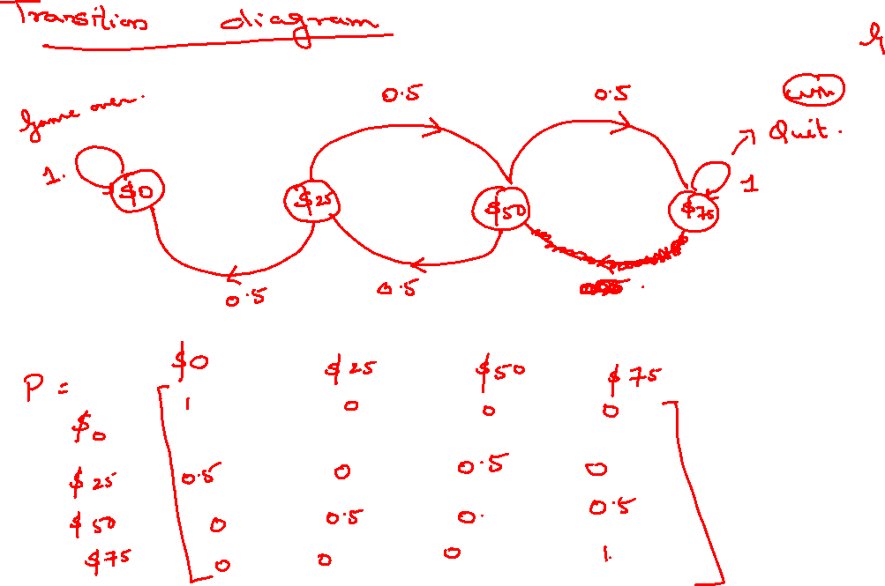

Slide 4
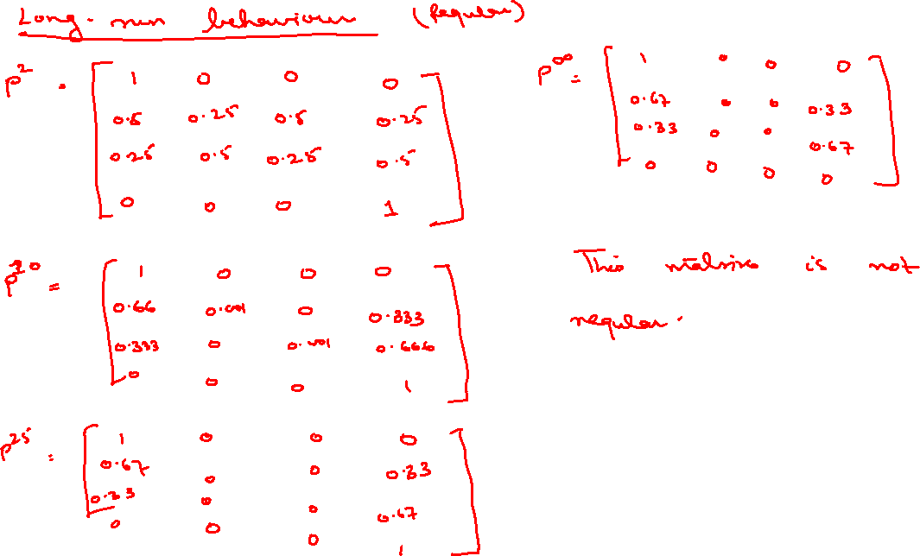

Slide 5
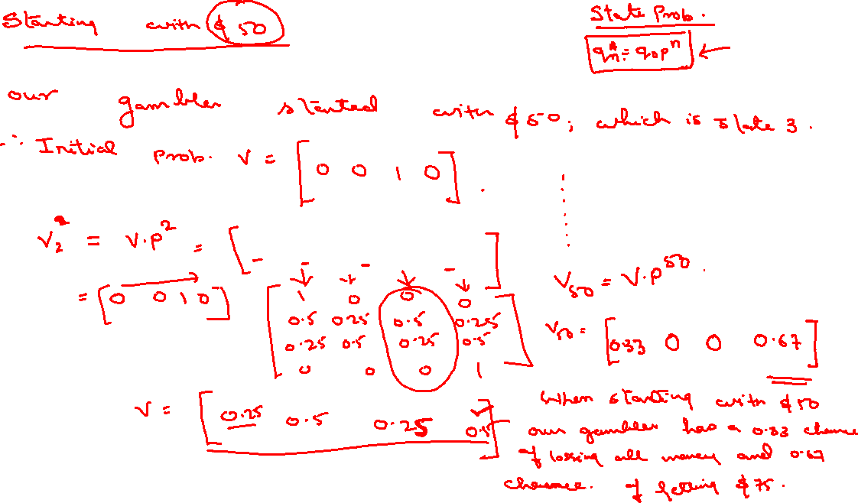
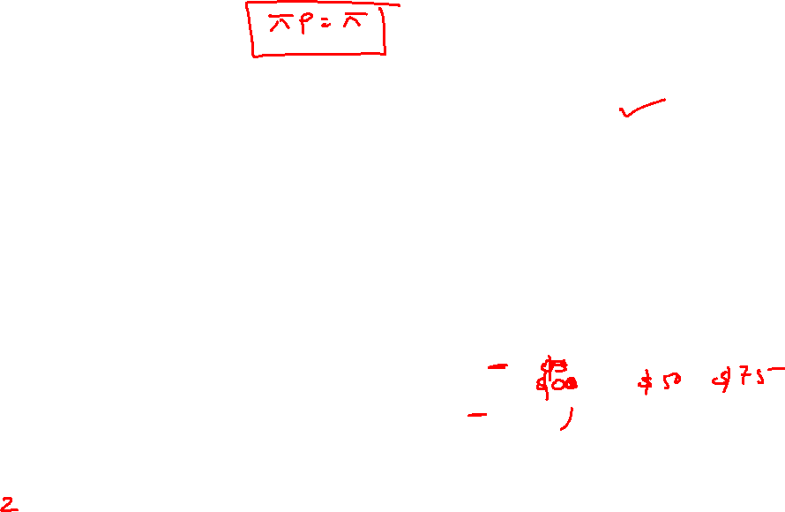

Slide 6
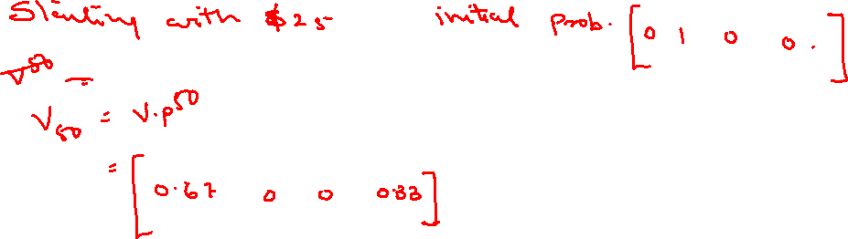
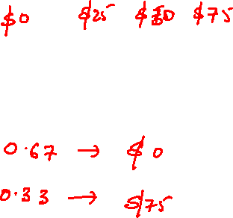

Slide 7
Random Walk
A random walk is a sequence of discrete, fixed-length steps in random directions.
Random walks may be 1-dimensional, 2- dimensional, or n-dimensional for any n.

Slide 8
The Simplest Random Walk: Walking in One Dimension
Random walks are simplest when they’re taken in one dimension.
Imagine standing at the point 0 on a number line or balance beam, where you have two possible directions for movement– forwards or backwards.
Flip a coin to choose your direction, heads is forward, tails is back. After every flip of the coin, you take just one step; then flip again.
8

Slide 9
The Simplest Random Walk: Walking in One Dimension
Note this random walk series is different than a series of random numbers because each number in a series a modification of the previous number.
9

Slide 10
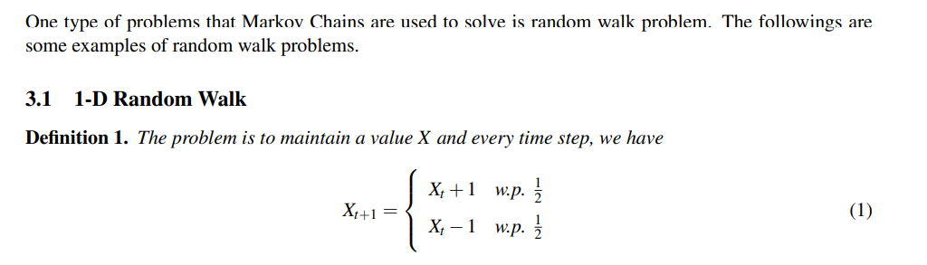
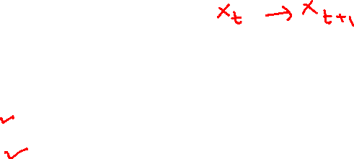


Slide 11
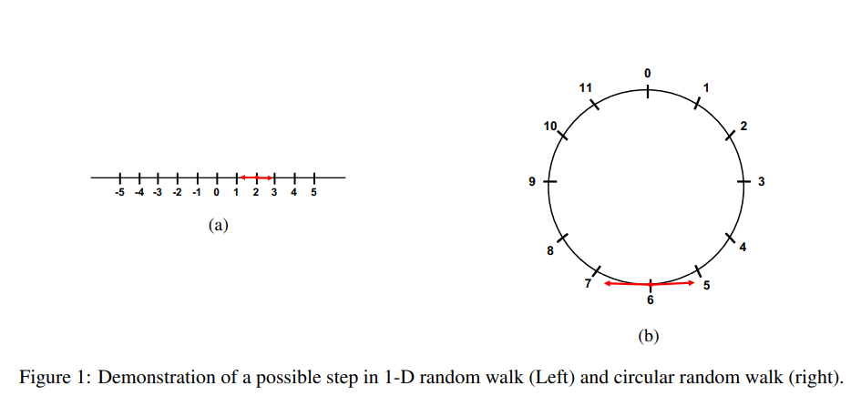
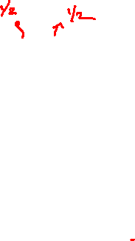

Slide 12
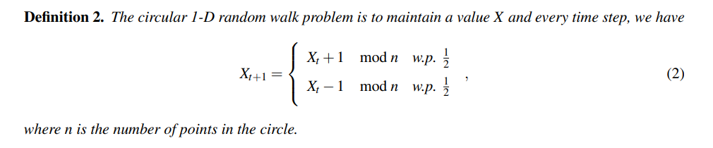
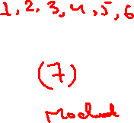

Slide 13
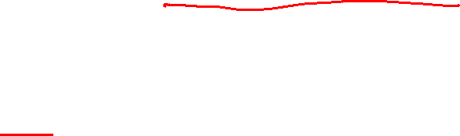
Random Walks in Two Dimensions
To imagine a random walk in two dimensions, imagine you had four possible directions you could move — right, left, forward or back.
To choose the direction for each step, you flip a coin twice.
The first flip decides between right/left and forward/back, the next one decides which of the two directions you go.
13

Slide 14
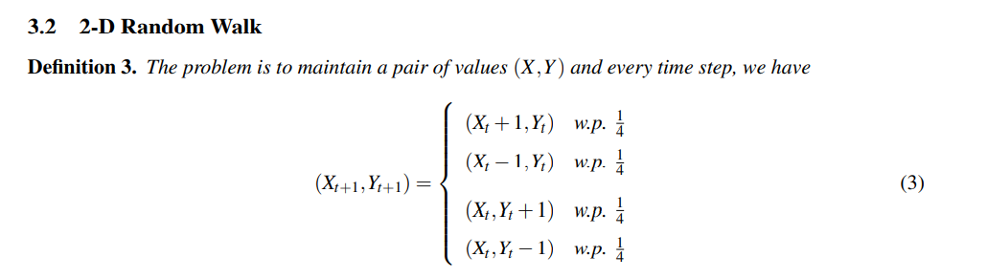
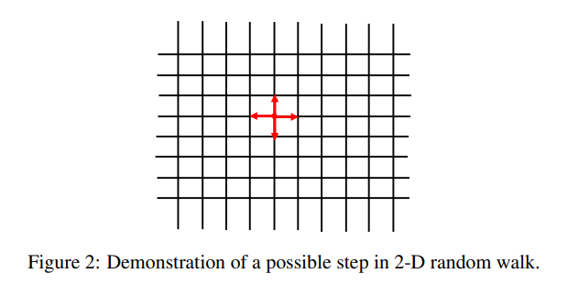

Slide 15
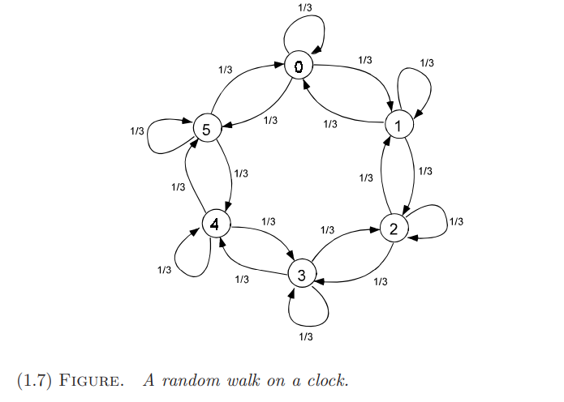

Slide 16
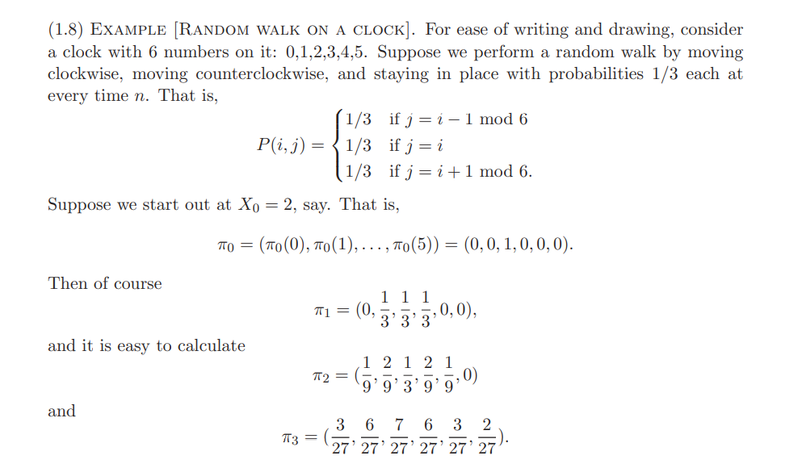
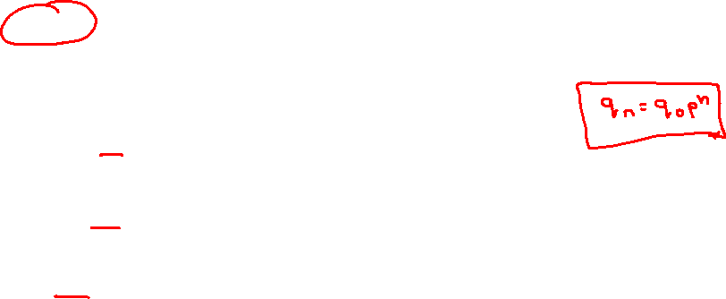
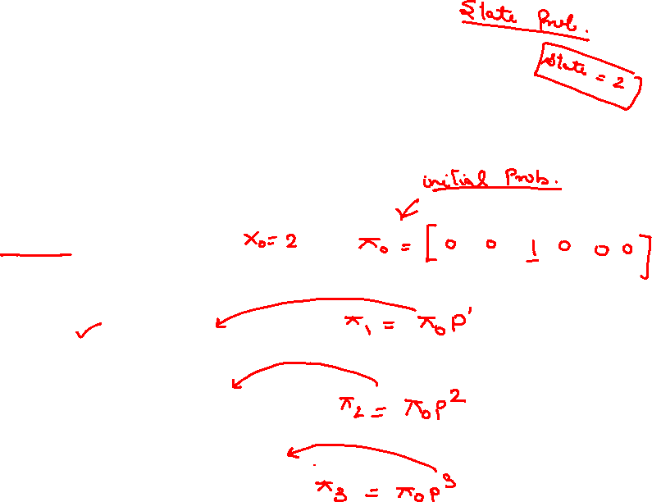

Slide 17
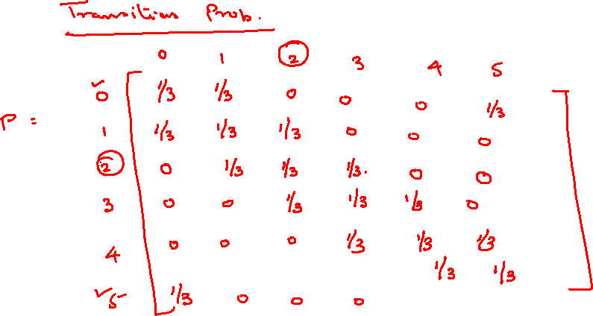

Slide 19
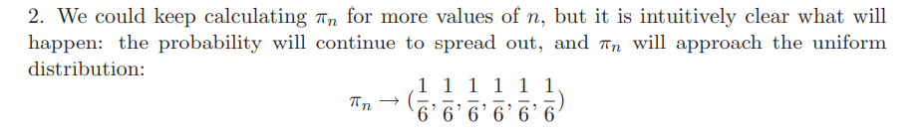

Slide 20
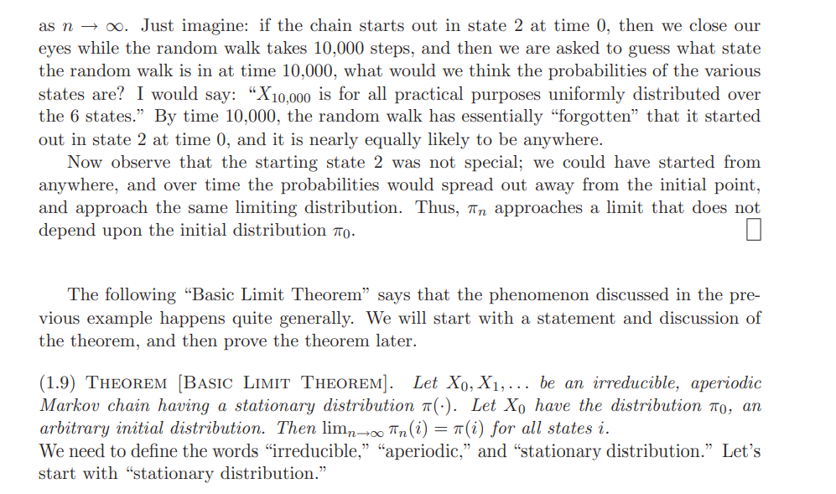
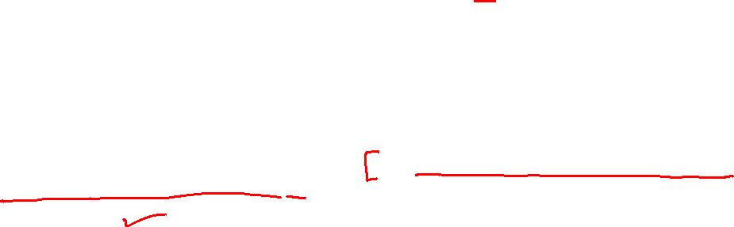
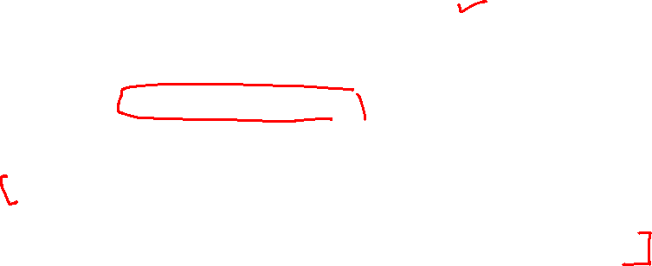

Slide 21
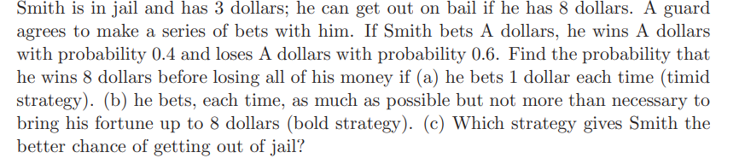
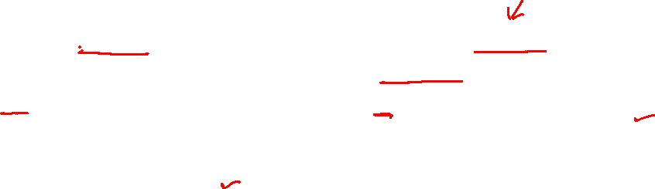

Slide 22
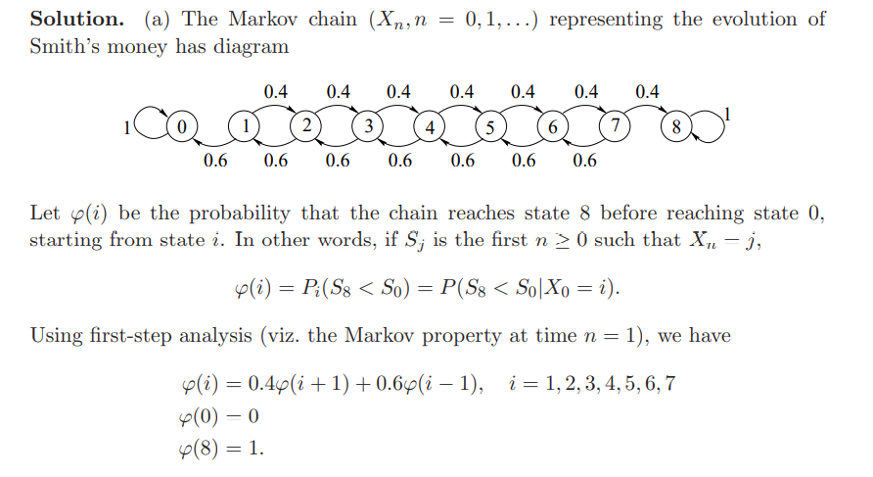
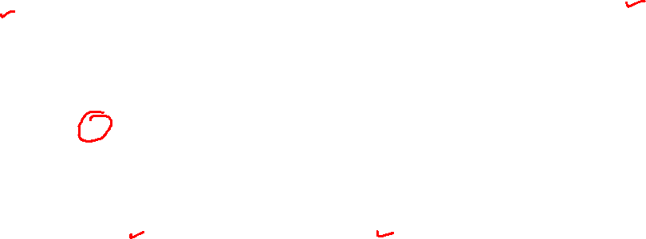
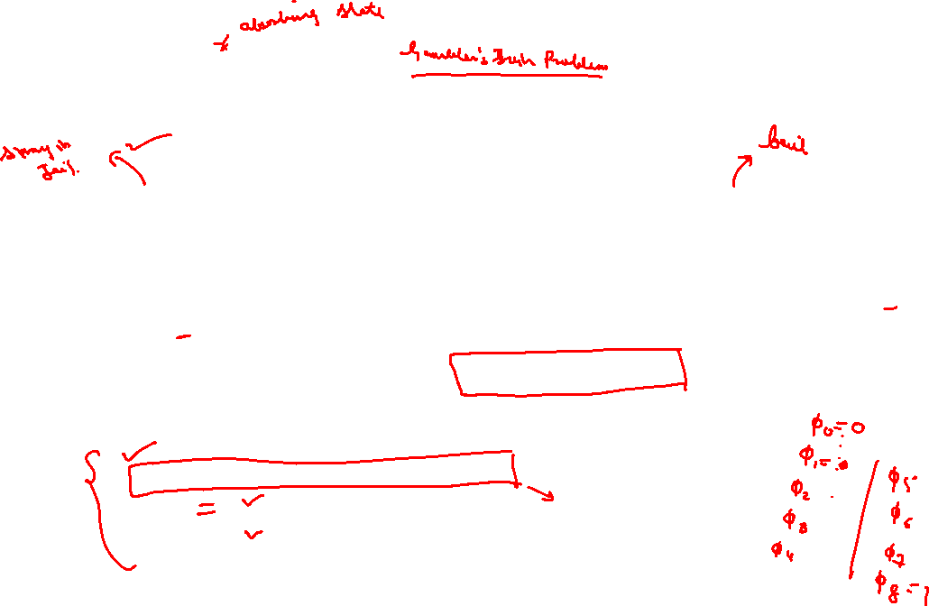

Slide 23
